Slide 1
Essentials of
Systems Analysis and Design
Sixth Edition
Joseph S. Valacich
Joey F. George
Jeffrey A. Hoffer
Chapter 9
Designing Databases
9.1

Slide 2
Learning Objectives
Define each of the following database terms
  Relation
  Primary key
  Functional dependency
  Foreign key
  Referential integrity
  Field
  Data type
  Null value
  Denormalization
  File organization
  Index
  Secondary key
9.2

Slide 3
Learning Objectives (continued)
Discuss the role of designing databases in the analysis and design of an information system
Learn how to transform an Entity-Relation (ER) Diagram into an equivalent set of well-structured relations
Learn how to merge normalized relations from separate user views into a consolidated set of well-structured relations
9.3

Slide 4
Learning Objectives (continued)
Explain choices of storage formats for database tables
Learn how to transform well-structured relations into efficient database tables
Discuss use of different types of file organizations to store database files
Discuss indexes and their purpose
9.4

Slide 5
Process of Database Design
Logical Design
  Based upon the conceptual data model
  Four key steps:
    1. Develop a logical data model for each known user interface for the application using normalization principles
    2. Combine normalized data requirements from all user interfaces into one consolidated logical database model
    3. Translate the conceptual E-R data model for the application into normalized data requirements
    4. Compare the consolidated logical database design with the translated E-R model and produce one final logical database model for the application
9.5

Slide 6
Process of Database Design (continued)
Physical Design
  Based upon results of logical database design
  Key decisions:
    Choosing storage format for each attribute from the logical database model
    Grouping attributes from the logical database model into physical records
    Arranging related records in secondary memory (hard disks and magnetic tapes) so that records can be stored, retrieved, and updated rapidly
    Selecting media and structures for storing data to make access more efficient
9.6

Slide 7
Process of Database Design (continued)
Primary Key
  An attribute whose value is unique across all occurrences of a relation
9.7

Slide 8
Deliverables and Outcomes
Logical database design must account for every data element, system input or output
Normalized relations are the primary deliverable
Physical database design results in converting relations into files
9.8

Slide 9
Relational Database Model
Data represented as a set of related tables or relations
Relation
  A named, two-dimensional table of data. Each relation consists of a set of named columns and an arbitrary number of unnamed rows
  Properties
    Entries in cells are simple
    Entries in columns are from the same set of values
    Each row is unique
    The sequence of columns can be interchanged without changing the meaning or use of the relation
    The rows may be interchanged or stored in any sequence
9.9

Slide 10
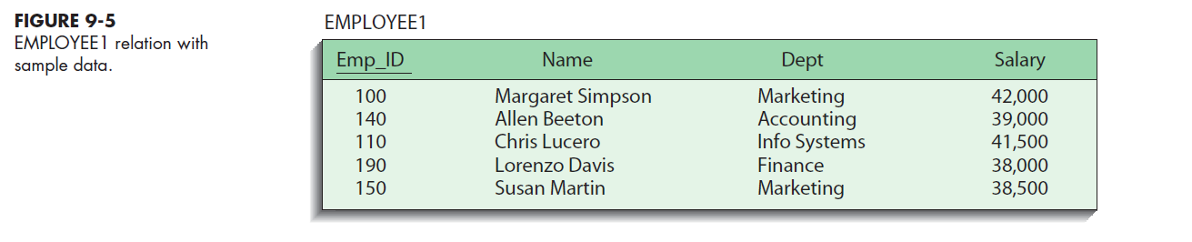
Relational Database Model (continued)
Well-Structured Relation
  A relation that contains a minimum amount of redundancy and allows users to insert, modify, and delete the rows without errors or inconsistencies
9.10

Slide 11
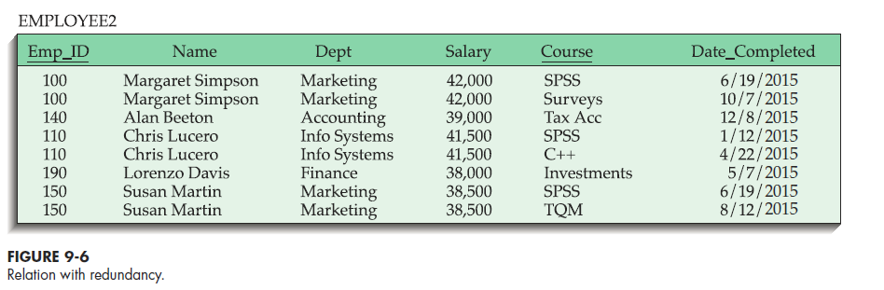
Normalization
The process of converting complex data structures into simple, stable data structures
Eliminates redundancy (see Figure 9-6)
9.11

Slide 12
Normalization (continued)
Second Normal Form (2NF)
  Each nonprimary key attribute is identified by the whole key (called full functional dependency)
Third Normal Form (3NF)
  Nonprimary key attributes do not depend on each other (called transitive dependencies)
The result of normalization is that every nonprimary key attribute depends upon the whole primary key.
9.12

Slide 13
Functional Dependencies and Primary Keys
Functional Dependency
  A particular relationship between two attributes. For a given relation, attribute B is functionally dependent on attribute A if, for every valid value of A, that value of A uniquely determines the value of B.
  Instances (or sample data) in a relation do not prove the existence of a functional dependency
  Knowledge of problem domain is the most reliable method for identifying functional dependency
9.13

Slide 14
Functional Dependencies and Primary Keys (continued)
Second Normal Form (2NF)
  A relation is in second normal form (2NF) if any of the following conditions apply:
    The primary key consists of only one attribute
    No nonprimary key attributes exist in the relation
    Every nonprimary key attribute is functionally dependent on the full set of primary key attributes
9.14

Slide 15
Functional Dependencies and
Primary Keys (continued)
Conversion to second normal form (2NF)
  To convert a relation into 2NF, decompose the relation into new relations using the attributes, called determinates, that determine other attributes
  The determinates become the primary key of the new relation
9.15

Slide 16
Functional Dependencies and
Primary Keys (continued)
Third Normal Form (3NF)
  A relation is in third normal form (3NF) if it is in second normal form (2NF) and there are no functional (transitive) dependencies between two (or more) nonprimary key attributes
  To convert a relation into 2NF, decompose the relation into two relations using the two determinants
9.16

Slide 17
9.17

Slide 18
Functional Dependencies and
Primary Keys (continued)
Foreign Key
  An attribute that appears as a nonprimary key attribute in one relation and as a primary key attribute (or part of a primary key) in another relation
Referential Integrity
  An integrity constraint specifying that the value (or existence) of an attribute in one relation depends on the value (or existence) of the same attribute in another relation
9.18

Slide 19
Transforming E-R Diagrams into Relations
It is useful to transform the conceptual data model into a set of normalized relations
Steps:
  Represent entities
  Represent relationships
  Normalize the relations
  Merge the relations
9.19

Slide 20
Transforming E-R Diagrams into Relations (continued)
Represent Entities
  Each regular entity is transformed into a relation
  The identifier of the entity type becomes the primary key of the corresponding relation
  The primary key must satisfy the following two conditions
    The value of the key must uniquely identify every row in the relation
    The key should be non-redundant
9.20

Slide 21
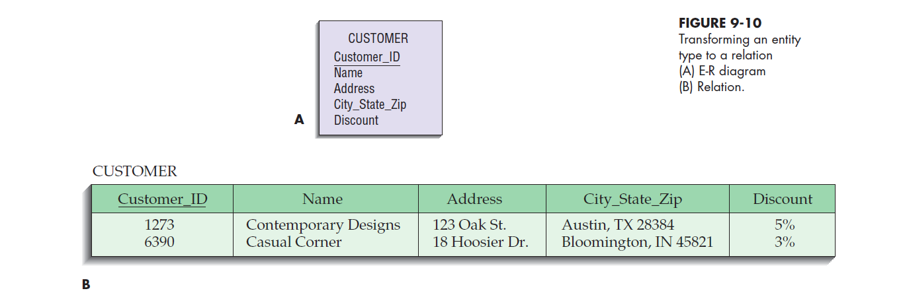
9.21

Slide 22
Transforming E-R Diagrams into Relations (continued)
Represent Relationships
  Binary 1:N Relationships
    Add the primary key attribute (or attributes) of the entity on the one side of the relationship as a foreign key in the relation that is on the right side
    The one side migrates to the many side
9.22

Slide 23
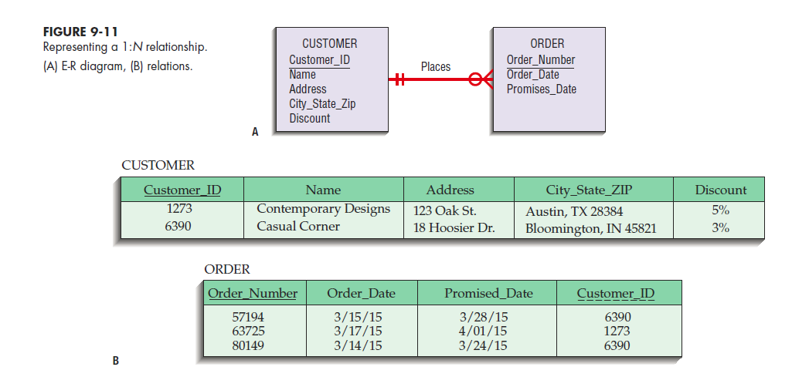
9.23

Slide 24
Transforming E-R Diagrams into Relations (continued)
Represent Relationships (continued)
  Binary or Unary 1:1
    Three possible options:
      Add the primary key of A as a foreign key of B
      Add the primary key of B as a foreign key of A
      Both
  Binary and higher M:N relationships
    Create another relation and include primary keys of all relations as primary key of new relation
9.24

Slide 25
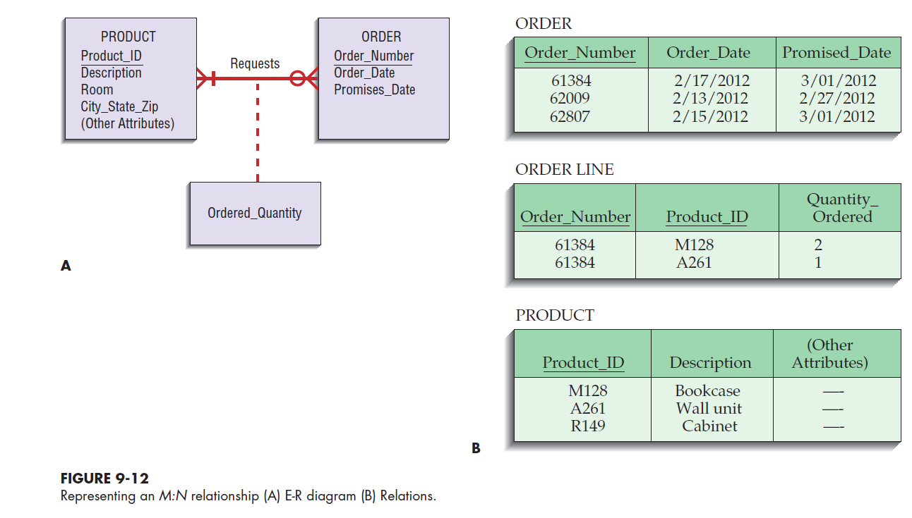
9.25

Slide 26
Transforming E-R Diagrams into Relations (continued)
  Unary 1:N Relationships
    Relationship between instances of a single entity type
    Utilize a recursive foreign key
      A foreign key in a relation that references the primary key values of that same relation
  Unary M:N Relationships
    Create a separate relation
    Primary key of new relation is a composite of two attributes that both take their values from the same primary key
9.26

Slide 27
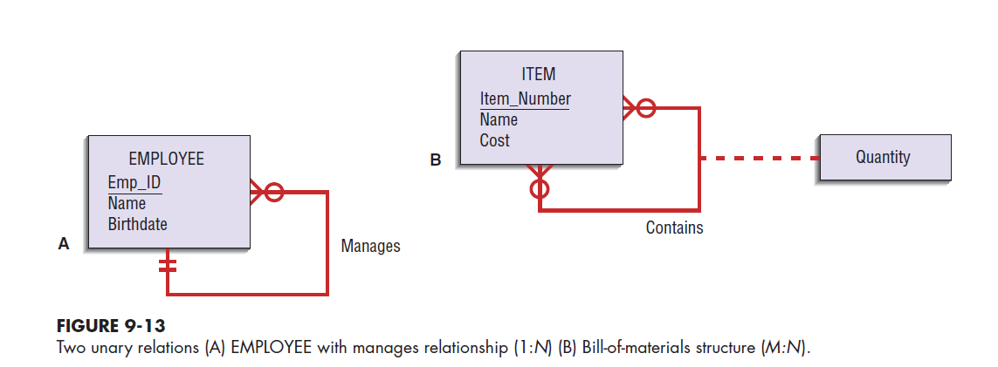
9.27

Slide 28
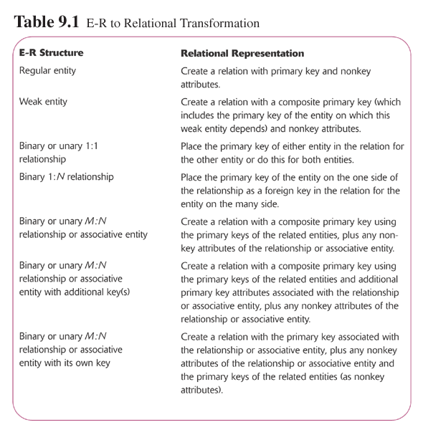
9.28

Slide 29
Transforming E-R Diagrams into Relations (continued)
Merging Relations (View Integration)
  Purpose is to remove redundant relations
  View Integration Problems
    Synonyms
      Two different names used for the same attribute
      When merging, get agreement from users on a single, standard name
    Homonyms
      A single attribute name that is used for two or more different attributes
      Resolved by creating a new name
    Dependencies between nonkeys
      Dependencies may be created as a result of view integration
      In order to resolve, the new relation must be normalized
9.29

Slide 30
Physical File and Database Design
The following information is required
  Normalized relations, including volume estimates
  Definitions of each attribute
  Descriptions of where and when data are used, entered, retrieved, deleted, and updated (including frequencies)
  Expectations or requirements for response time and data integrity
  Descriptions of the technologies used for implementing the files and database
9.30

Slide 31
Designing Fields
Field
  The smallest unit of named application data recognized by system software
  Each attribute from each relation will be represented as one or more fields
Choosing data types
  Data Type
    A coding scheme recognized by system software for representing organizational data
  Four objectives:
    Minimize storage space
    Represent all possible values for the field
    Improve data integrity for the field
    Support all data manipulations desired on the field
  Calculated fields
    A field that can be derived from other database fields
9.31

Slide 32
Controlling Data Integrity
Default Value
  A value a field will assume unless an explicit value is entered for that field
Input Mask
  A pattern of codes that restricts the width and possible values for each position of a field
Range Control
  Limits range of values that can be entered into field
Referential Integrity
  An integrity constraint specifying that the value (or existence) of an attribute in one relation depends on the value (or existence) of the same attribute in another relation
Null Value
  A special field value, distinct from 0, blank or any other value, that indicates that the value for the field is missing or otherwise unknown
9.32

Slide 33
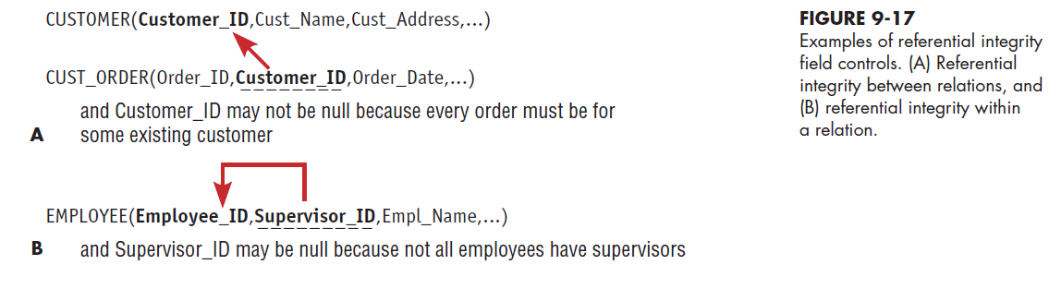
9.33

Slide 34
Designing Physical Tables
Relational Database is a Set of Related Tables
Physical Table
  A named set of rows and columns that specifies the fields in each row of the table
Design Goals
  Efficient use of secondary storage (disk space)
    Disks are divided into units that can be read in one machine operation
    Space is used most efficiently when the physical length of a table row divides close to evenly with storage unit
9.34

Slide 35
Designing Physical Tables (continued)
Design Goals (continued)
  Efficient data processing
    Data are most efficiently processed when stored next to each other in secondary memory
Denormalization
  The process of splitting or combining normalized relations into physical tables based on affinity of use of rows and fields
  Optimizes certain operations at the expense of others
  Three common situations where denormalization may be used:
    Two entities with a one-to-one relationship
    A many-to-many relationship with nonkey attributes
    Reference data
9.35

Slide 36
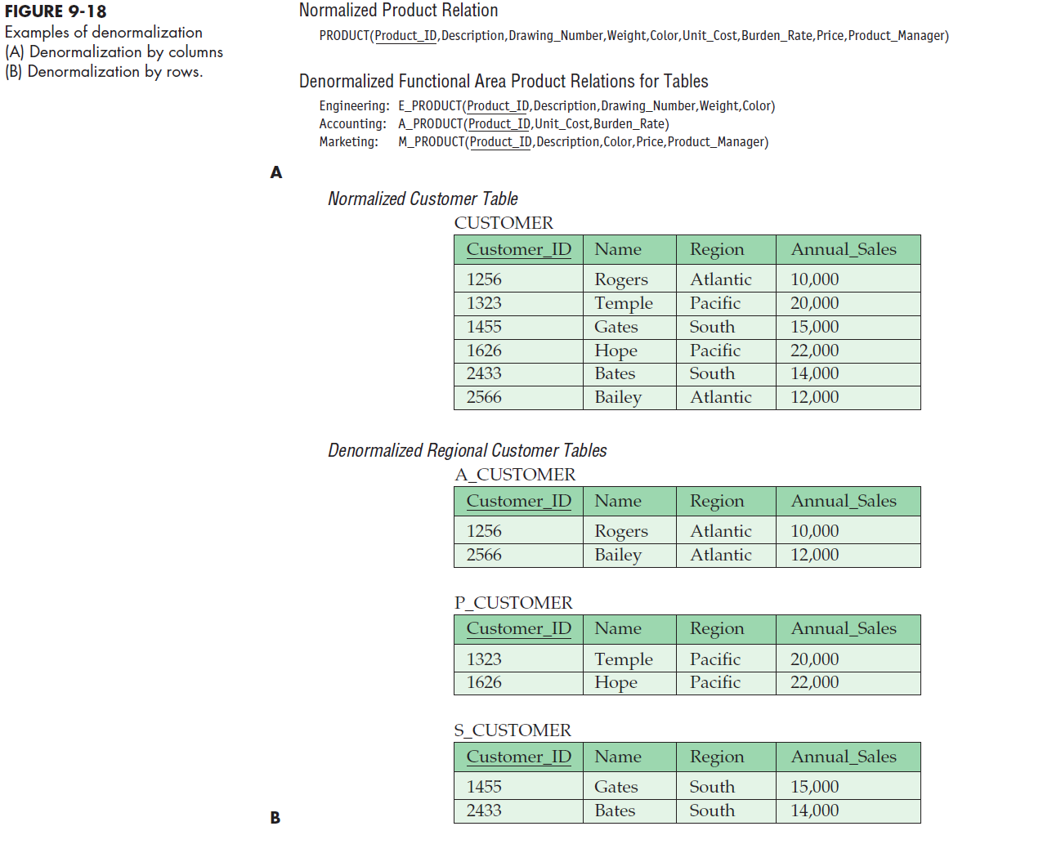
9.36

Slide 37
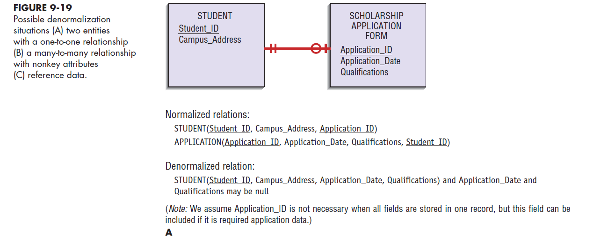
9.37

Slide 38
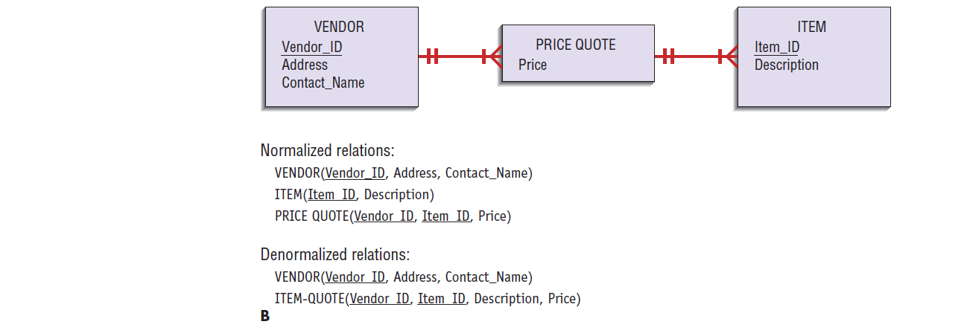
9.38

Slide 39
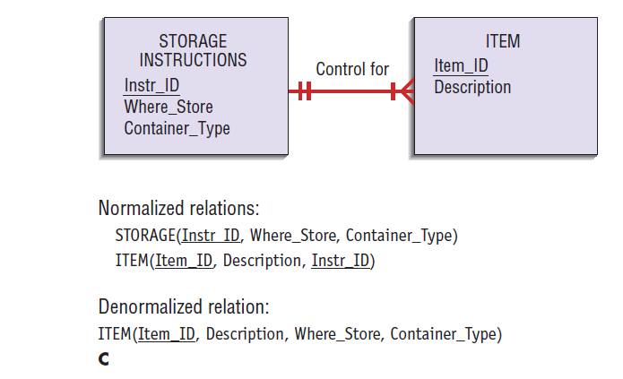
9.39

Slide 40
Designing Physical Tables (continued)
Arranging Table Rows
  Physical File
    A named set of table rows stored in a contiguous section of secondary memory
  Each table may be a physical file or whole database may be one file, depending on database management software utilized
9.40

Slide 41
Designing Physical Tables (continued)
File Organization
  A technique for physically arranging the records of a file
  Objectives for choosing file organization:
    Fast data retrieval
    High throughput for processing transactions
    Efficient use of storage space
    Protection from failures or data loss
    Minimizing need for reorganization
    Accommodating growth
    Security from unauthorized use
9.41

Slide 42
Designing Physical Tables (continued)
Types of File Organization
  Sequential
    The rows in the file are stored in sequence according to a primary key value
    Updating and adding records may require rewriting the file
    Deleting records results in wasted space
  Indexed
    The rows are stored either sequentially or non-sequentially and an index is created that allows software to locate individual rows
    Index
      A table used to determine the location of rows in a file that satisfy some condition
    Secondary Index
      Index based upon a combination of fields for which more than one row may have same combination of values
9.42

Slide 43
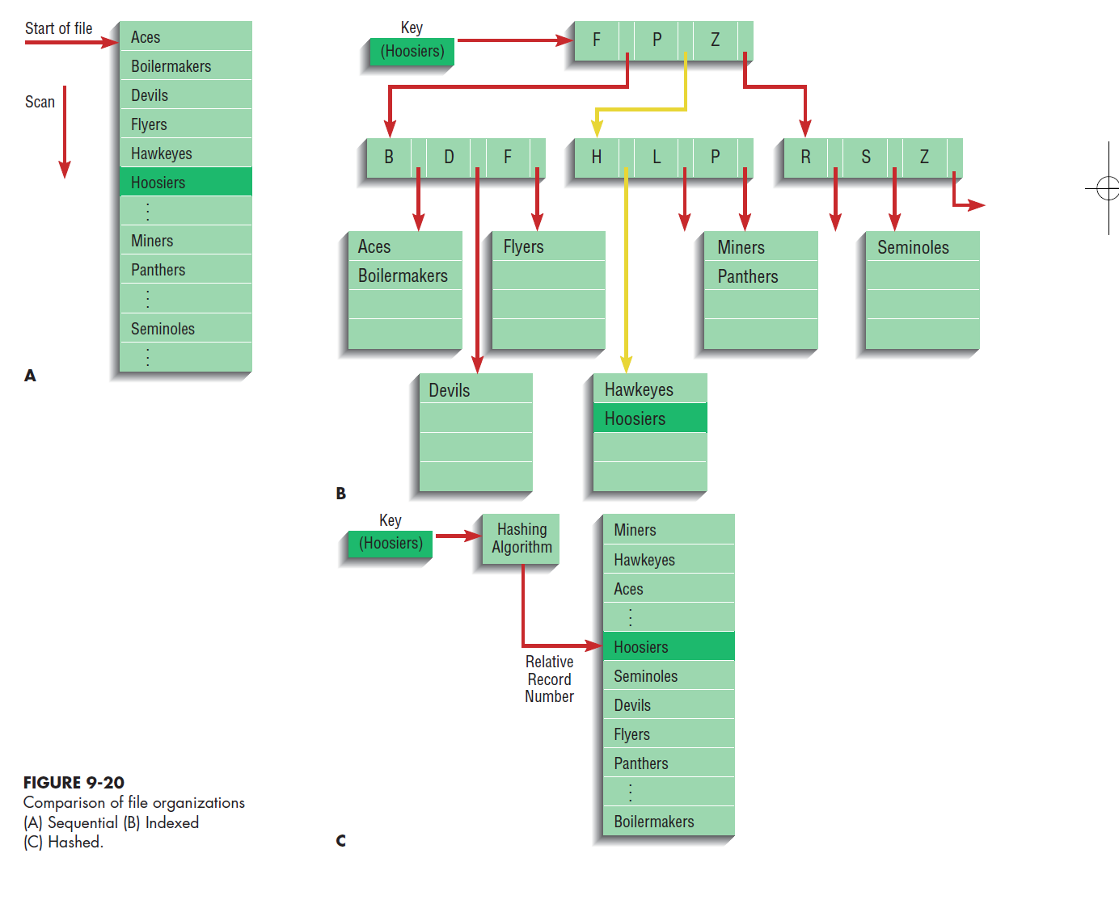
9.43

Slide 44
Designing Physical Tables (continued)
Guidelines for choosing indexes
  Specify a unique index for the primary key of each file
  Specify an index for foreign keys
  Specify an index for nonkey fields that are referenced in qualification, sorting, and grouping commands for the purpose of retrieving data
Hashed File Organization
  The address for each row is determined using an algorithm
9.44

Slide 45
Designing Controls for Files
Backup Techniques
  Periodic backup of files
  Transaction log or audit trail
  Change log
Data Security Techniques
  Coding, or encrypting
  User account management
  Prohibiting users from working directly with the data; users work with a copy which updates the files only after validation checks
9.45

Slide 46
PVF WebStore:
Designing Databases
Design process is no different than for other applications
9.46

Slide 47
Summary
Key Terms
  Relation
  Primary key
  Functional dependency
  Foreign key
  Referential integrity
  Field
  Data type
  Denormalization
  File organization
  Index
  Secondary key
9.47

Slide 48
Summary (continued)
Transforming E-R diagram into well-structured relations
View Integration
Storage Formats for Database Fields
Efficient Database Table Design
  Efficient use of secondary storage
  Data processing speed
File Organization
Indexes
Internet Development
9.48

Slide 49

All rights reserved. No part of this publication may be reproduced, stored in a retrieval system, or transmitted, in any form or by any means, electronic, mechanical, photocopying, recording, or otherwise, without the prior written permission of the publisher. Printed in the United States of America.
Copyright © 2015 Pearson Education, Inc.
Publishing as Prentice Hall

